Slide 1
Pattern Recognition Mean-shift for image segmentation
Erbene Castro

Slide 2
Summary
Project Scope
Mean-shift Algorithm
Non-negative matrix factorization (NMF)
Image Segmentation
Brain MRI Images
What are Local histograms?
Building the dataset
Results

Slide 3
Project Scope
Perform image segmentation (pixel clustering) on brain MRI using Mean-shift algorithm
Compare results with image segmentation using NMF

Slide 4
Mean Shift Algorithm
Mean shift is a procedure for locating the maxima—the modes—of a density function given discrete data sampled from that function.
Uses a non-parametric approach to density estimation within a region (kernel). Attempts to find the local modes of this density.
All points that lead to the same mode form a cluster.

Slide 5
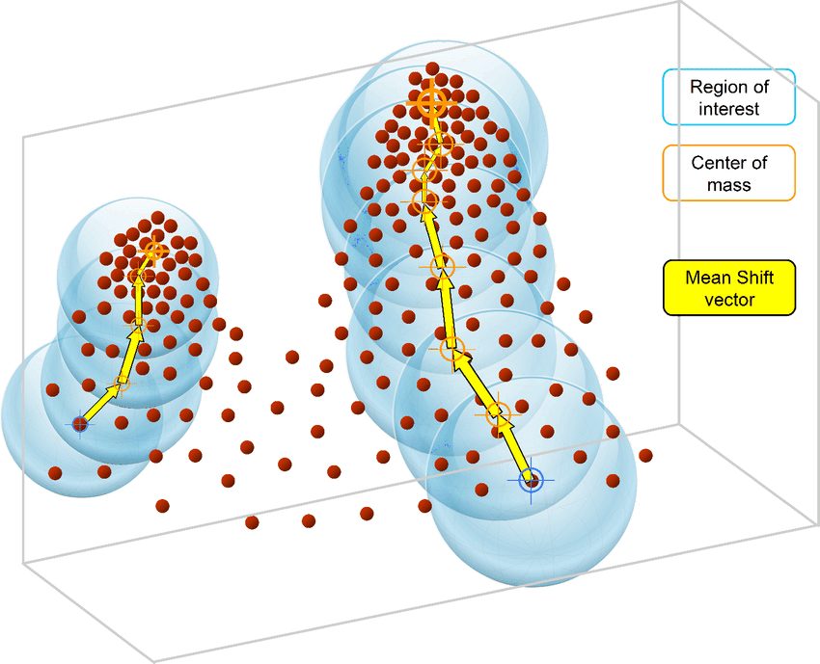
Mean Shift Algorithm
Consider a set of points in three-dimensional space. Assume a circular window centered at C and having radius r as the kernel.
Mean shift is a hill climbing algorithm which involves shifting this kernel iteratively to a higher density region until convergence.
Every shift is defined by a mean shift vector. The mean shift vector always points toward the direction of the maximum increase in the density.
At every iteration the kernel is shifted to the centroid or the mean of the points within it.
Original image from: https://www.researchgate.net/figure/Intuitive-description-of-the-mean-shift-procedure-find-the-densest-regions-in-the_fig3_326242239

Slide 6
Mean Shift Algorithm
The method of calculating this mean depends on the choice of the kernel.
If a flat kernel is chosen, every point will be shifted using the mean of the points within the window.
if a Gaussian kernel is chosen instead of a flat kernel, then every point will first be assigned a weight which will decay exponentially as the distance from the kernel's center increases. At convergence, there will be no direction at which a shift can accommodate more points inside the kernel.
Original image from: https://www.researchgate.net/figure/Intuitive-description-of-the-mean-shift-procedure-find-the-densest-regions-in-the_fig3_326242239

Slide 7

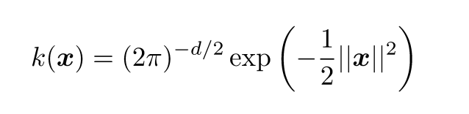
Mean Shift Algorithm
The two most used kernels are:
Flat kernel:
Gaussian kernel:
* GIF animation from: https://spin.atomicobject.com/2015/05/26/mean-shift-clustering/

Slide 8
Mean Shift Algorithm Implementation details
The implementation of this algorithm is done considering a rectangular window with size to me passed as input
This implementation considers a flat kernel.
Bandwidth and tolerance can be passed as parameters. In this case, tolerance is used as a stop measure when shifting points. If a shift has a “walk” distance less than tolerance, we reached our goal.
All cluster vectors are rounded up to two decimal places and points are grouped by cluster vector.

Slide 9
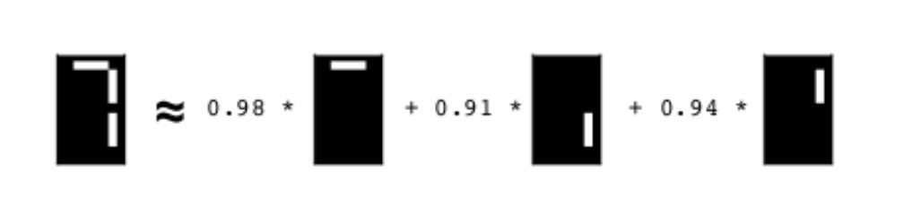
What really NMF does and why?
Condenses high-dimensional data into lower-dimensional models
NMF decomposes samples as a weighted sum of its components (or features)
Models are easy to visualize and explain
Simplifies analysis
* Image taken from: https://campus.datacamp.com/courses/unsupervised-learning-in-python/discovering-interpretable-features?ex=1

Slide 10
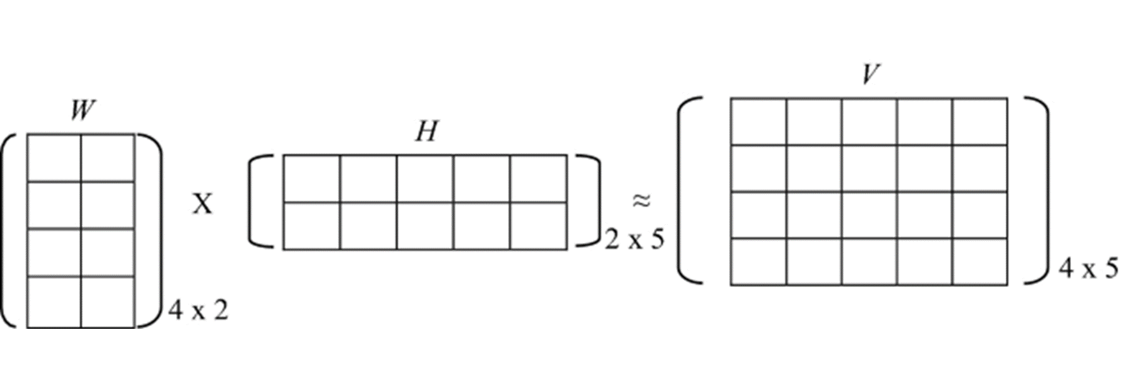
What is non-negative matrix factorization (NMF)?
The matrix V must have all values non-negative
* Image from https://en.wikipedia.org/wiki/Non-negative_matrix_factorization

Slide 11

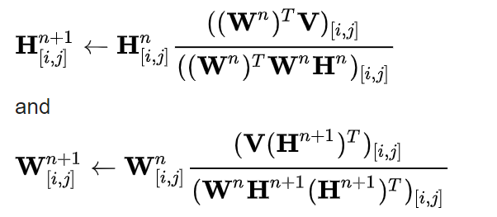
How do we calculate W and H?
We initialize W and H with random non-negative values.
We can have different loss functions, that we want to minimize, and regularizations.
Example:
Loss function: The squared error a.k.a Frobenius Norm
Iterative Algorithm: Multiplicative update rule

Slide 12
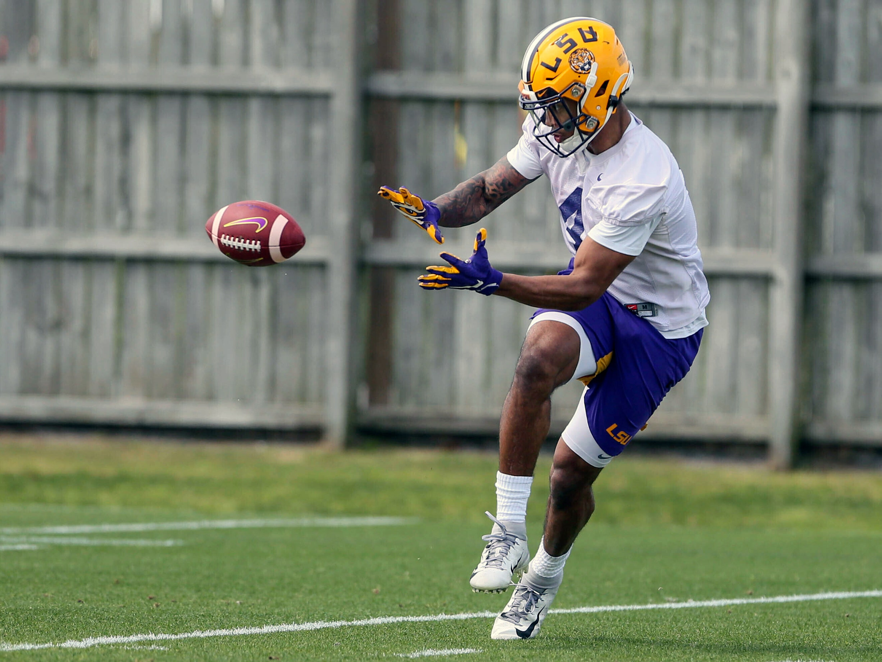
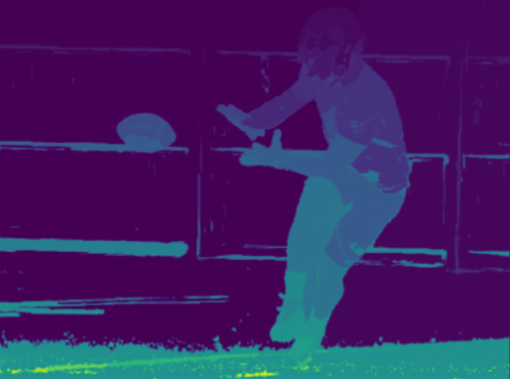
Image Segmentation
Break up image into similar regions. Cluster pixels according to similar properties (e.g., pixel intensity, colors, etc.)
* Image taken from: Image segmentation using Felzenszwalb’s algorithm
(https://www.analyticsvidhya.com/blog/2021/05/image-segmentation-with-felzenszwalbs-algorithm/)

Slide 13
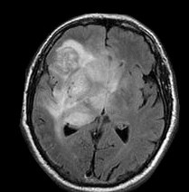
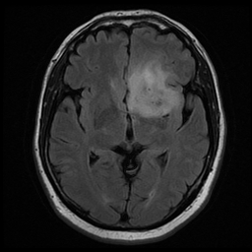
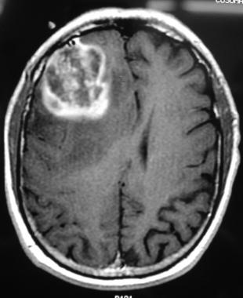
Brain MRI images
Inputs:
Images from Kaggle brain tumor challenge dataset
(https://www.kaggle.com/navoneel/brain-mri-images-for-brain-tumor-detection)
Brain MRI images in grayscale
Image sizes: Image 1 (209x212), Image 2 (256x256) and Image 3 (310x380)
Each pixel represents a sample, the features are grayscale local histograms

Slide 14
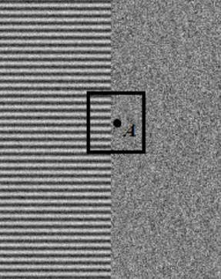
What are local histograms?
A local histogram of an image is a histogram of the values of the pixels that lie in a neighborhood of a given pixel’s location.
It indicates the combination of pixel intensities or colors that appear in that neighborhood.
When used as features in an image classification scheme, such histograms can help distinguish one texture from another
* Image taken from: https://sites.google.com/site/factorizationsegmentation/

Slide 15
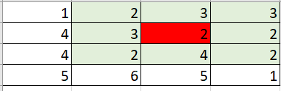
Building the dataset
For each pixel, calculate local histograms bins:
With the normalized values for each pixel, the sample matrix is created:
Local Histogram bins | Pixel count | Normalized value
range 0 - 1 | 0 | 0
range 2 - 3 | 8 | 0.888888889
range 4 - 5 | 1 | 0.111111111
range 6 - 7 | 0 | 0
…
Pixel Position | range 0 - 1 | range 2 - 3 | range 4 - 5 | range 6 - 7 | …
(0,0) | 0.2 | 0.3 | 0 | 0.5 | …
(0,1) | 0.1 | 0.2 | 0 | 0.7 | …
(0,2) | 0.5 | 0 | 0 | 0.5 | …
… | … | … | … | … | …

Slide 16
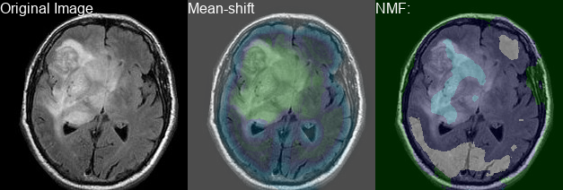
Results Image 1
Considering 5 local histogram bins

Slide 17
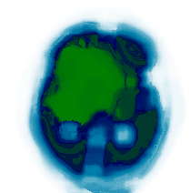
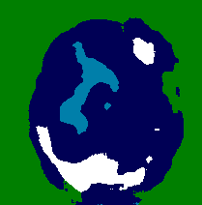
Results Image 1
Original image x Mean-shift texture x NMF texture

Slide 18
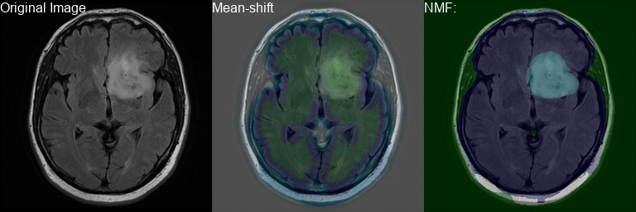
Results Image 2
Considering 5 local histogram bins

Slide 19
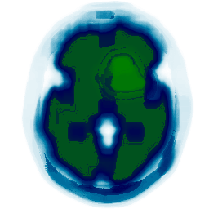
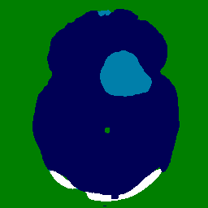
Results Image 2
Original image x Mean-shift texture x NMF texture

Slide 20
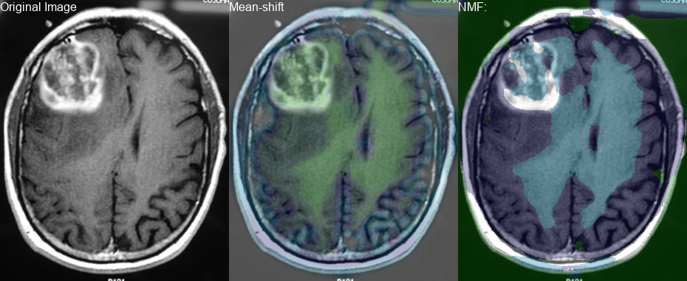
Results Image 3
Considering 5 local histogram bins

Slide 21
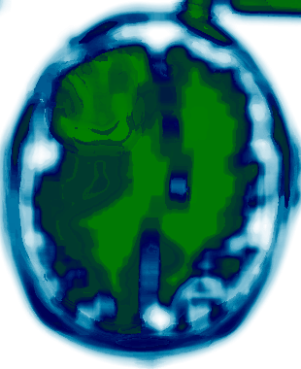
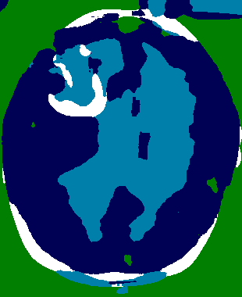
Results Image 3
Original image x Mean-shift texture x NMF texture

Slide 22
References
https://www.cs.rochester.edu/u/jliu/CSC-576/NMF-tutorial.pdf
https://scfbm.biomedcentral.com/articles/10.1186/1751-0473-8-10
https://www.kaggle.com/navoneel/brain-mri-images-for-brain-tumor-detection
https://en.wikipedia.org/wiki/Mean_shift
http://www.ipb.uni-bonn.de/html/teaching/photo12-2021/2021-pho1-12-segmentation.pptx.pdf

